Slide 1
Booth Analytics Club: Introduction to R
Raj Ghosh
October 21, 2017

Slide 2
Overview
Why should I use it?
How do I use it?
Libraries
in R
What is R?

Slide 3
What is R?
Why should I use it?
How do I use it?
Libraries
in R
What is R?

Slide 4
What is R?
R is an open source programming language for statistical computing and plotting that is supported by the R Foundation for Statistical Computing
R is widely used among statisticians and data scientists for data analysis
R's popularity has increased substantially in recent years

Slide 5
What is R?
R is an interpreted computer language.
Most user-visible functions are written in R itself, calling upon a smaller set of internal primitives.
It is possible to interface procedures written in C, C+, or FORTRAN languages for efficiency, and to write additional primitives.
System commands can be called from within R
R is used for data manipulation, statistics, and graphics. It is made up of:
operators (+ - <- * %*% …) for calculations on arrays & matrices
large, coherent, integrated collection of functions
facilities for making unlimited types of publication quality graphics
user written functions & sets of functions (packages); 800+ contributed packages so far & growing

Slide 6
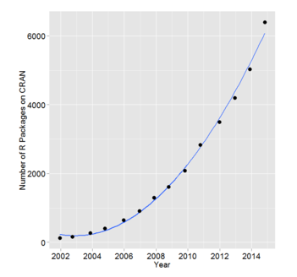
Brief History of R
Initially written & released as an open source implementation of S programming language by Ross Ihaka and Robert Gentleman in 1995
Since 1997: International group of R-users have been sharing their libraries with the world

Slide 7
Why should I use it?
What is R?
Why should I use it?
How do I use it?
Libraries
in R

Slide 8
Why should I use it?
It's free!
It runs on a variety of platforms including Windows, Unix and MacOS.
It provides an unparalleled platform for programming new statistical methods in an easy and straightforward manner.
It contains advanced statistical routines not yet available in other packages.
It has state-of-the-art graphics capabilities.

Slide 9
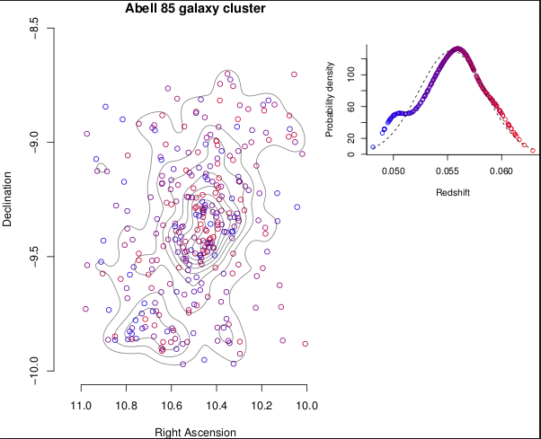
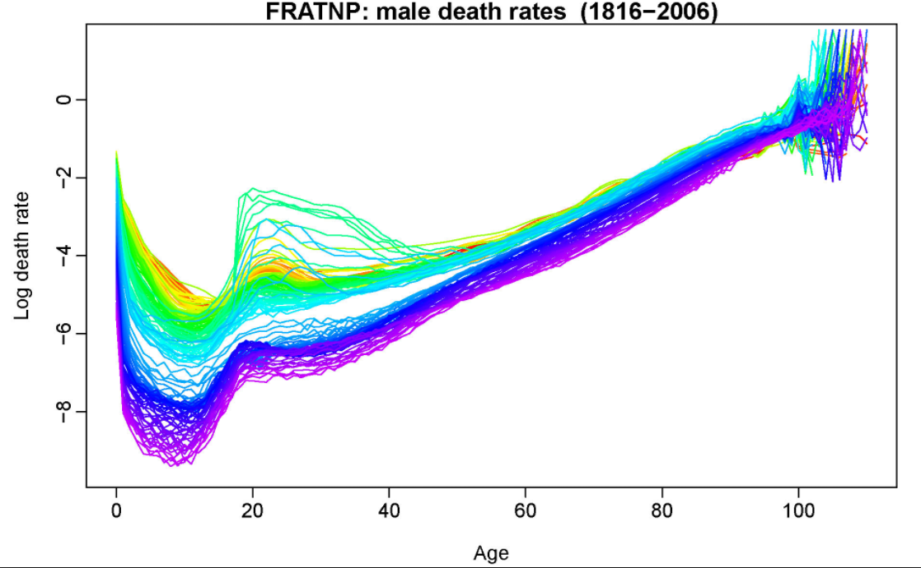
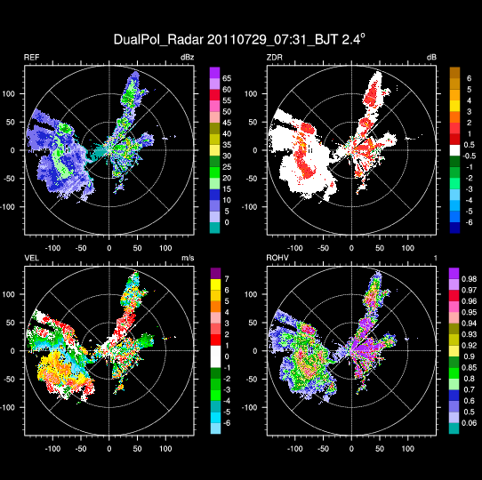
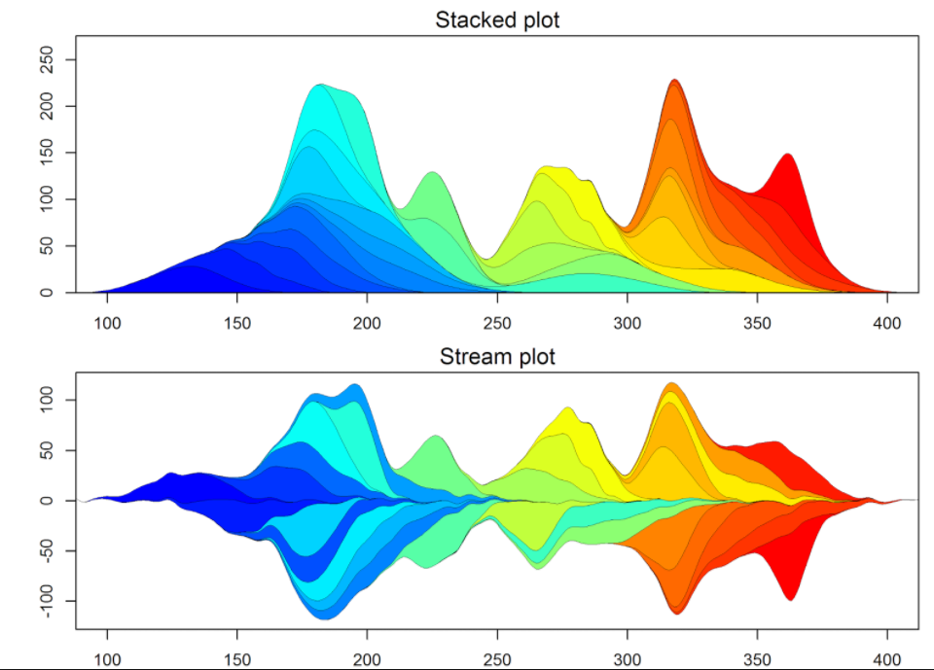
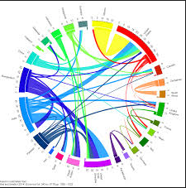
Graphing capabilities

Slide 10
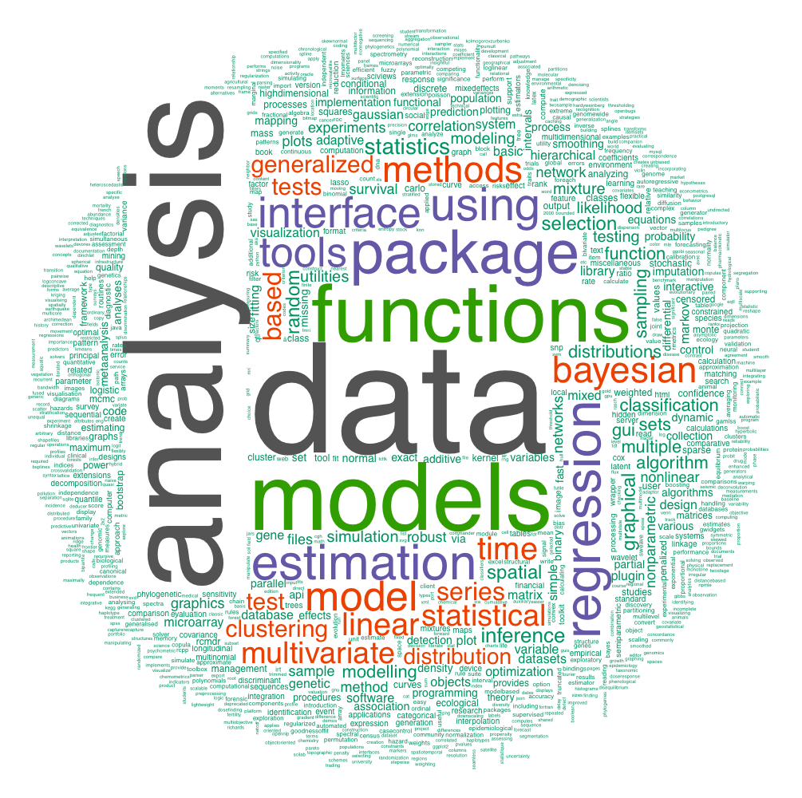
Libraries, Libraries, Libraries

Slide 11
How do I use it?
What is R?
Why should I use it?
How do I use it?
Libraries
in R

Slide 12
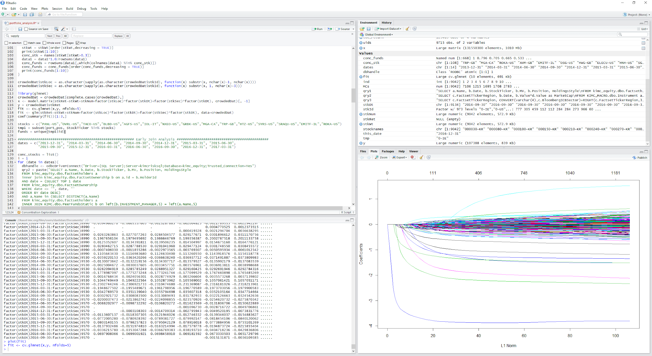
How do you use R?
RStudio is an integrated development environment (IDE) for R
Notes:
Demonstrate the GUI here. Go over tables databases, fields, and properties

Slide 13
Data Types
R has a wide variety of data types including scalars, vectors (numerical, character, logical), matrices, dataframes, and lists.
Vectors:
Numeric vector: c(1,2,5.3,6,-2,4) #
Character vector: c("one","two","three")
Logical vector: c(TRUE,TRUE,TRUE,FALSE,TRUE,FALSE)
Refer to elements of a vector using subscripts:
a[2] (2nd element of vector a)
Notes:
Demonstrate the GUI here. Go over tables databases, fields, and properties

Slide 14
Data Types
Matrices: All columns in a matrix must have the same mode (numeric, character, etc.) and the same length.
The general format is:
mymatrix <- matrix(vector, nrow=r, ncol=c, byrow=FALSE,dimnames=list(char_vector_rownames, char_vector_colnames))
byrow=TRUE indicates that the matrix should be filled by rows. byrow=FALSE indicates that the matrix should be filled by columns (the default). dimnames provides optional labels for the columns and rows.
Notes:
Demonstrate the GUI here. Go over tables databases, fields, and properties

Slide 15
Data Types
Matrix example:
# another example cells <- c(1,26,24,68) rnames <- c("R1", "R2") cnames <- c("C1", "C2") mymatrix <- matrix(cells, nrow=2, ncol=2, byrow=TRUE, dimnames=list(rnames, cnames))
Identify rows, columns or elements using subscripts:
x[,4] # 4th column of matrix x[3,] # 3rd row of matrix x[2:4,1:3] # rows 2,3,4 of columns 1,2,3
Notes:
Demonstrate the GUI here. Go over tables databases, fields, and properties

Slide 16
Data Types
Dataframes: A data frame is more general than a matrix, in that different columns can have different modes (numeric, character, factor, etc.).
d <- c(1,2,3,4), e <- c("red", "white", "red", NA)
mydata <- data.frame(d,e)
names(mydata) <- c("ID","Color")
Identify the elements of a dataframe:
myframe[3:5] # columns 3,4,5 of dataframe
myframe[c("ID","Age")] # columns ID and Age from dataframe
myframe$X1 # variable x1 in the dataframe
Notes:
Demonstrate the GUI here. Go over tables databases, fields, and properties

Slide 17
Data Types
Lists: An ordered collection of objects (components). A list allows you to gather a variety of (possibly unrelated) objects under one name.
Example of a list with 4 different components: w <- list(name="Fred", mynumbers=a, mymatrix=y, age=5.3)
Identify elements of a list:
mylist[[2]] # 2nd component of the list
Notes:
Demonstrate the GUI here. Go over tables databases, fields, and properties

Slide 18
Missing Data
In R, missing values are represented by the symbol NA (not available) .
Impossible values (e.g., dividing by zero) are represented by the symbol NaN (not a number).
Testing for Missing Values:
is.na(x) # returns TRUE of x is missing
y <- c(1,2,3,NA)
is.na(y) # returns a vector (F F F T)
Notes:
Demonstrate the GUI here. Go over tables databases, fields, and properties

Slide 19
Loading Data
From File: CSV
read.csv("readcsv.csv", header=T, dec=".",sep="\t")
From Database: SQL
library(RODBC)
dbhandle <- odbcDriverConnect("Driver={SQL Server};Server=Server_Name;Database=DB_Name;Trusted_Connection=Yes")
myDF <- sqlQuery(dbhandle, qry) #qry is in SQL
close(dbhandle)
Notes:
Demonstrate the GUI here. Go over tables databases, fields, and properties

Slide 20
Manipulating Data
Operators:
Arithmetic Operators
Operator Description
+ addition
- subtraction
* multiplication
/ division
^ or ** exponentiation
x %% y modulus (x mod y) 5%%2 is 1
x %/% y integer division 5%/%2 is 2
Logical Operators
Operator Description
< less than
<= less than or equal to
> greater than
>= greater than or equal to
== exactly equal to
!= not equal to
!x Not x
x | y x OR y
x & y x AND y
isTRUE(x) test if X is TRUE
Notes:
Demonstrate the GUI here. Go over tables databases, fields, and properties

Slide 21
Manipulating Data
Control Structures: R has the standard control structures as in other programming languages. However, it is more efficient to use built-in functions rather than control structures whenever possible.
Control Structure Syntax
If-else: if (cond) {expr1} else {expr2}
For: for (var in seq) {expr}
While: while (cond) {expr }
Switch: switch(expr, ...)
Notes:
Demonstrate the GUI here. Go over tables databases, fields, and properties

Slide 22
Manipulating Data
User-defined functions: Can define your own functions in R
<function name> <- function(<variables list>) {
<expr>
return(<output variable>)
}
Example:
add <- function(x, y) {
return(x + y)
}
Notes:
Demonstrate the GUI here. Go over tables databases, fields, and properties

Slide 23
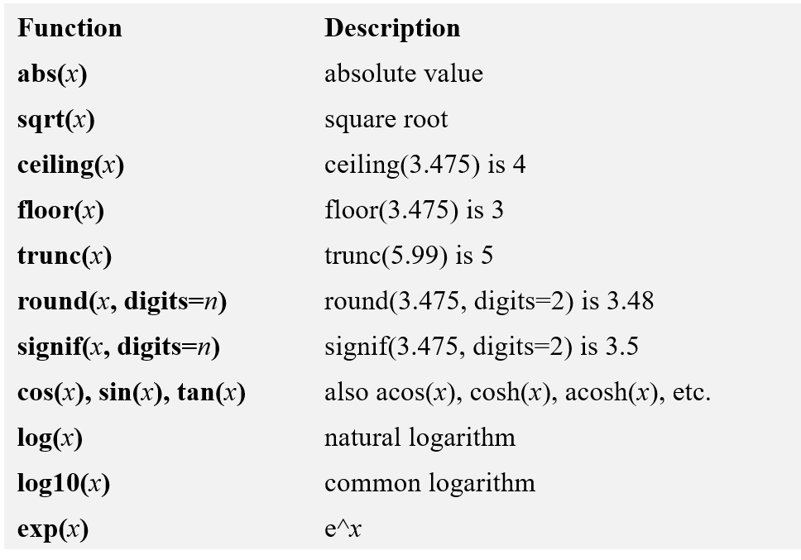
Manipulating Data
Built-in functions: Already provided in R.
Numeric Functions
Notes:
Demonstrate the GUI here. Go over tables databases, fields, and properties

Slide 24
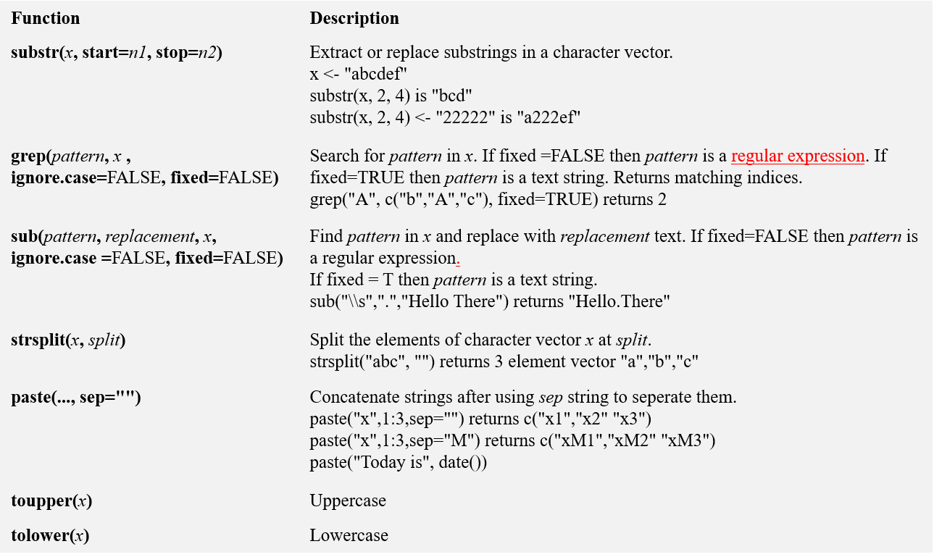
Manipulating Data
Character Functions
Notes:
Demonstrate the GUI here. Go over tables databases, fields, and properties

Slide 25
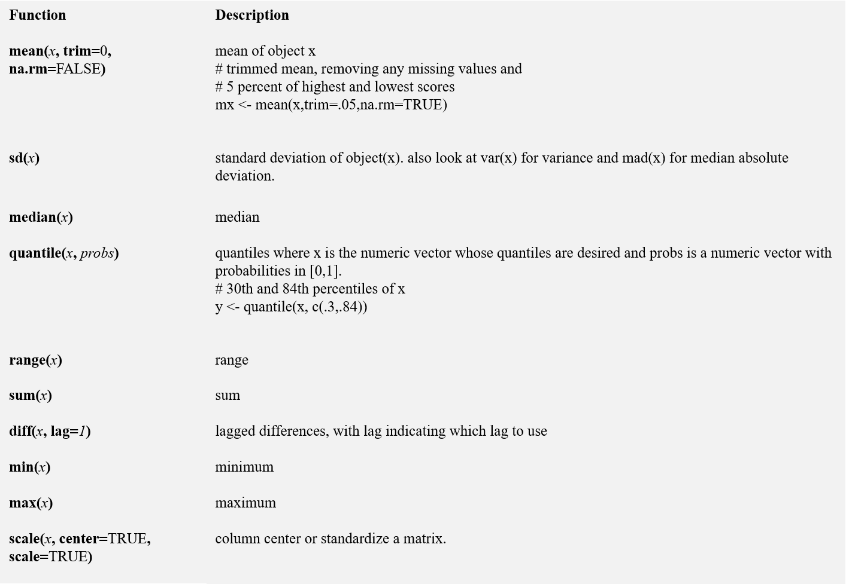
Manipulating Data
Statistical Functions
Notes:
Demonstrate the GUI here. Go over tables databases, fields, and properties

Slide 26
Manipulating Data
Other Useful functions:
length(object) # number of elements in vector/list
dim(object) # dimensions of matrix/dataframe
nrow/ncol(object) # number of rows/cols
(row/col)names(object) # (row/col) names of object
c(object,object,...) # combine objects into a vector
cbind(object, object, ...) # combine objects as columns
rbind(object, object, ...) # combine objects as rows
subset(dataframe, condition) # slices dataframe based on condition
which(condition) # returns indices of vector which satisfy the condition
match(vector1, vector2) # indices of vector 1 elements in vector 2
order(vector, decreasing = TRUE) # ordered indices of vector
merge(dataframe1, dataframe2, by = vector of fields) # SQL inner join
Notes:
Demonstrate the GUI here. Go over tables databases, fields, and properties

Slide 27
Plotting Results
One of the main reasons data analysts turn to R is for its strong graphic capabilities.
Scatter Plots
plot(x,y)
Example: attach(mtcars) plot(wt, mpg) abline(lm(mpg~wt)) title("Regression of MPG on Weight")
Notes:
Demonstrate the GUI here. Go over tables databases, fields, and properties

Slide 28
Libraries in R
What is R?
Why should I use it?
How do I use it?
Libraries
in R

Slide 29
Regression Analysis
R has a number of useful libraries for analytics:
Regression Analysis (gamlr, glmnet)
Machine Learning (randomForest, neuralnet, e1071, caret, xgboost)
Text Mining (tm, tidytext, textir)
Plotting (ggplot2)
Data Manipulation (plyr, dplyr, reshape2, data.table)
Notes:
Demonstrate the GUI here. Go over tables databases, fields, and properties

Slide 30
Regression Analysis
R provides comprehensive support for multiple linear regression. The topics below are provided in order of increasing complexity.
Multiple Linear Regression Example: fit <- lm(y ~ x1 + x2 + x3, data=mydata) summary(fit) # show results
Other useful functions: coefficients(fit) # model coefficients confint(fit, level=0.95) # CIs for model parameters fitted(fit) # predicted values residuals(fit) # residuals anova(fit) # anova table vcov(fit) # covariance matrix for model parameters influence(fit) # regression diagnostics
Predicting new results: yhat <- predict(fit,xnew)
Notes:
Demonstrate the GUI here. Go over tables databases, fields, and properties

Slide 31
Regression Analysis
Advanced functionality for regression:
Regression with categorical variables:
fit <- lm(y ~ x1 + x2 + factor(x3), data=mydata)
Regression with interaction terms:
fit <- lm(y ~ x1 + x2*x3, data=mydata)
Regression with non-linear terms:
fit <- lm(y ~ x1 + x2**2 + x3, data=mydata)
Logistic regression:
fit <- lm(y ~ x1 + x2**2 + x3, data=mydata, family=“binomial”)
Notes:
Demonstrate the GUI here. Go over tables databases, fields, and properties

Slide 32
Conclusion
Provided introduction to R
Much more functionality available
Resources to use:
https://cran.r-project.org/
https://stackoverflow.com/
Notes:
Demonstrate the GUI here. Go over tables databases, fields, and properties

Slide 33
Thank you

